Slide 1
CPU Organization Course
Alexander Titov
23 December 2014

Slide 2
Introduction
Who am I?
Hardware Architect
7 years in hardware industry (mostly RnD)
4 years of teaching experience
Why are we here?
To better understand how microprocessor (CPU) works

Slide 3

ONE DOES NOT SIMPLY
STUDY MICROPROCESSORS

Slide 4


Today’s Goal
Try to hit the tip of the “iceberg”
Explain the main concepts only
Not enough to develop your own microprocessor…
But, allow better understanding behavior of your programs
Processor Microarchitecture for SW engineers

Slide 5
Course Roadmap
Day 1
Pipeline
Memory Hierarchy (Caches)
Day 2
Out-of-order execution
Branch prediction
Day 3
Real example: Haswell Microarchitecture

Slide 6
Layers of Abstraction
Application
Application
Algorithms
Algorithms
Software (SW)
Programming Language
Programming Language
Operating System
Operating System
Interface between HW and SW
Instruction Set Architecture
Instruction Set Architecture
Microarchitecture
Microarchitecture
Gates/Register-Transfer Level (RTL)
Gates/Register-Transfer Level (RTL)
Hardware (HW)
Circuits
Circuits
Physics
Physics

Slide 7
Basic CPU Actions
4ns
8ns
time
F
D
E
M
W
Fetch instruction by PC from memory
Decode it and read its operands from registers
Perform calculation
Read/write memory
Write the result into the registers and update PC

Slide 8
Non-pipelined Processing
Sync signal
(clocks)
4ns
8ns
12ns
16ns
time
instr 0
F
D
E
M
W
F
D
E
M
W
F
D
E
M
F
D
E
M
W
instr 1
instr 0
instr 1
instr 2
instructions
F
D
E
M
instr 2
Instructions are processed sequentially, one per cycle
How to speedup?
SW:
HW:
decrease the number of instructions
decrease the time to process one instruction
or overlap their processing, i.e. make pipeline

Slide 9
Pipeline
Sync signal
(clocks)
4ns
8ns
12ns
16ns
time
F
F
D
D
E
E
M
M
W
instr 0
W
wait
wait
wait
wait
instr 1
F
D
E
M
W
wait
wait
instructions
F
D
E
M
W
instr 2
wait
wait
Processing is split into several steps called “stages”
Each stage takes one clock cycle
The clock cycle is determined by the longest stage
Instructions are overlapped
A new instruction occupies a stage as soon as the previous one leaves it

Slide 10
Pipeline vs. non-pipeline
Non-Pipelined
Sync signal
(clocks)
4ns
8ns
12ns
16ns
time
instr 0
F
D
E
M
W
8 ns
F
D
E
M
W
instr 1
instr 1
8 ns
instructions
F
D
E
M
W
instr 2
Pipelined
Pipeline improves throughput, not latency
Effective time to process instruction is one clock
Clock length is defined by the longest stage
Sync signal
(clocks)
4ns
8ns
12ns
time
pipeline fill
instr 0
F
D
wait
E
M
W
wait
2 ns
instr 1
F
D
wait
E
M
W
wait
2 ns
instructions
steady state
instr 2
F
D
wait
E
M
W
wait

Slide 11
Pipeline Limitations
Max speed of the pipeline is one instruction per clock
It is rare achievable due to dependencies among instructions (either data or control) and in-order processing
F | D | E | M | W
 | F | D | E | M | W
 |  | F | D | E | M | W
M | W
 |  |  | F | D | E | M | W
 |  |  |  | F | D | E | M | W
 |  |  |  |  | F | D | E | M | W
F | Stall
D | E | M | W
F | D | E | M | W
 | F | D | E | M | W

Slide 12
Memory Hierarchy

Slide 13
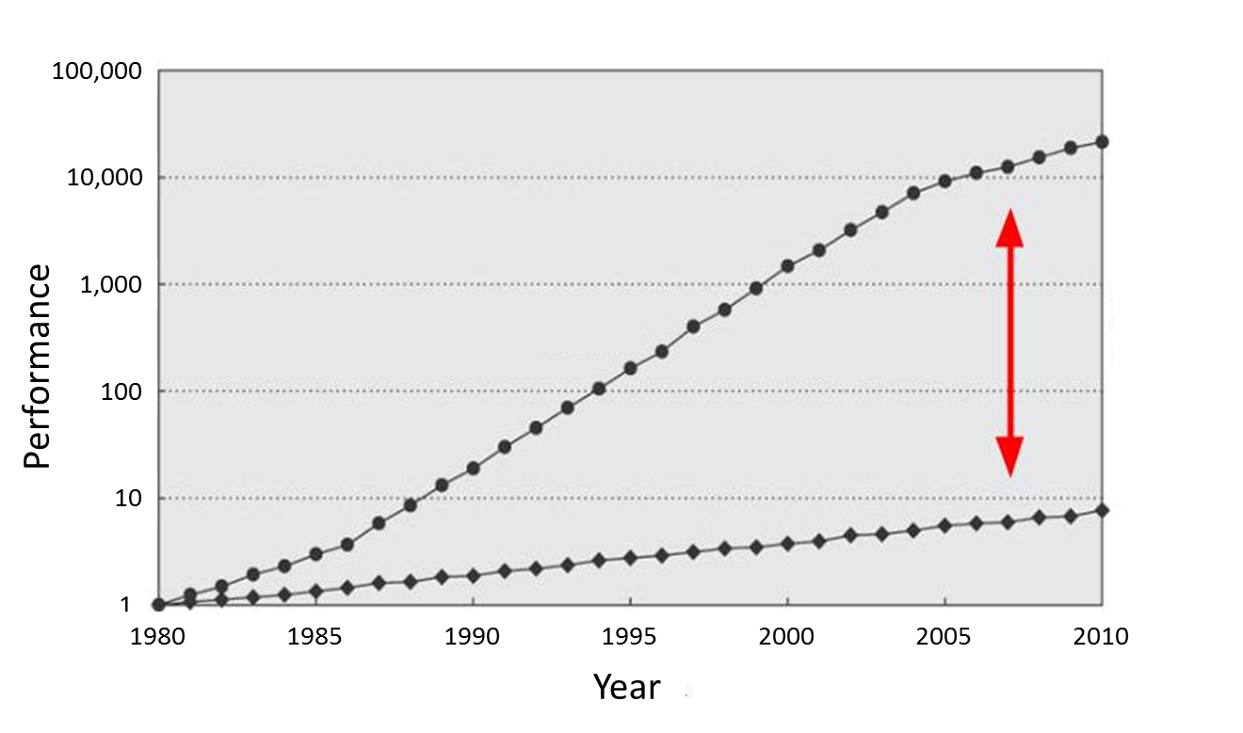
Motivation for Memory Hierarchy
CPU
60% per year
(Doubles every 1.5 year)
Performance gap
9% per year
(Doubles every 10 year)
DRAM

Slide 14
Memory Tradeoffs
Large memories are slow
Small memories are fast, but expensive and consume high power
Goal: give the processor a feeling that it has a memory which is fast, large, consumes low power and cheap
Solution: a Hierarchy of memories
CPU
L1
Cache
L2
Cache
L3
Cache
Memory
(DRAM)
Speed:
Capacity (size):
Cost:
Power:
Fastest
Smallest
Highest
Highest
Slowest
Biggest
Lowest
Lowest

Slide 15
Why Is It Works?
Temporal Locality (Locality in Time):
If an item is accessed, it will tend to be accessed again soon
Example: code and variables in loops
→ Keep recently accessed data closer to the processor
Spatial Locality (Locality in Space):
If an item is accessed, nearby items tend to be accessed soon
Example: scanning an array
→ Move contiguous blocks closer to the processor
Locality + smaller HW is faster memory → hierarchy

Slide 16
Cache: Main Idea
The cache holds a small part of the entire memory
Need to map parts of the memory into the cache
Main memory is virtually partitioned into lines
Typical block size is 32 to 64 bytes
Blocks are aligned
Memory
#line
0
1
2
3
4
5
6
…
…
91
92
93
…
…
The cache holds data by lines
Only a subset of the blocks is mapped to the cache at a given time
Address of lines is used as a key
Cache
#line
2
91
4
5

Slide 17
Cache Lookup
Case 1: Cache Hit
The requested line is in the cache
The cache returns the requested line (fast)
Case 2: Cache Miss
Memory
#line
0
1
2
3
4
5
6
…
…
91
92
93
…
…
Cache
#line
2
91
5
hit
4
4?
CPU

Slide 18
Cache Lookup
Case 1: Cache Hit
The requested line is in the cache
The cache returns the requested line (fast)
Case 2: Cache Miss
The requested line is not in the cache
Need to fetch it from the main memory (slow) and fill the cache
May need to evict another line from the cache to free space for the new one
Memory
line#
0
1
2
3
4
5
6
…
…
91
92
93
…
…
Cache
line#
91
5
2
93
miss
93?
4
93?
CPU

Slide 19
Fully Associative Cache
Line may be mapped to any cache entry
Lookup line in all entries
Address is partitioned to
Offset within a line (byte#)
Line # (so-called tag)
Each cache entry has a tag
All tags are compared to the line# in parallel
If one of the tags matches the line#, we have a hit
Address
64 | 5 | 0
Tag = line# | Offset
Tag
Array
Data
Array
63
0
0
1
…
511
=
=
…
…
=
…
hit/miss
data

Slide 20
Direct Map Cache
Line is mapped to the fixed entry only
Lookup line in one entry
Address is partitioned to
Offset within a line (byte #)
Set (fixed cache entry #)
Tag (works as a key)
Conflicts are possible
If several lines are mapped to the same entry, only one can reside in the cache
Address
64 | 14 |  | 5 | 0
Tag | Set |  | Offset
Data
Array
Tag Array
set#
63
0
0
1
…
511
…
=
hit/miss
data

Slide 21
Direct Map Memory Layout
Address
Memory is virtually partitioned
into lines
line size = 2 ^ offset_size
lines grouped into slices
# of lines in slices = 2 ^ set_size
slice size = # of lines in slice * line_size = cache size
slice # = tag value
line # inside a slice = set value
64
0
 | Offset
 | Set | Offset
Tag | Set | Offset
Memory Space
set#
cache size
set#
cache size
tag#
Mapped to the same set
set#
cache size
…
Disadvantage is line evictions due to set conflicts
set#
cache size

Slide 22
2-Way Set Associative Cache
Conflicts are harmful → multi-ways cache is a solution
Each set holds two entries (way 0 and way 1)
Each line can be mapped into one of two entries in the appropriate set
Address
64 | 13 |  | 5 | 0
Tag | Set |  | Offset
way #0
way #1
Tag Array
Data Array
Tag Array
Data Array
set#
63
0
set#
63
0
0
1
…
255
0
1
…
255

Slide 23
Multi-way Memory Layout
Memory is virtually partitioned almost the same as in direct map cache
The only difference is slice size
slice size = cache size / # of ways
Compared to direct map cache
Decrease slice size → increase # of slices → increase # of lines mapped to the same set
But in each set we can have multiple lines (= # of ways) at a given time
Memory Space
set#
way size
Mapped to the same set
…

Slide 24
2-Way Set Associative Cache
Address
64 | 13 |  | 5 | 0
Tag | Set |  | Offset
Tag Array
Data Array
way #0
way #1
way #0
way #1
set#
set#
63
0
63
0
0
1
…
255
0
1
…
255
=
=
MUX
hit/miss
data

Slide 25
Line Replacement Policies
Direct map
A new block is mapped to a single line in the cache
Old line is evicted (re-written to memory if needed)
N-way set associative cache
Choose a victim from all ways in the appropriate set
Replacement algorithms
FIFO (First In First Out)
Random
LRU (Least Recently used)
LRU is the best
but not that much better even than random

Slide 26
Cache Performance
Terms:
Miss Rate = Misses / total CPU request
Hit Rate = Hits / total CPU request = 1 – Miss Rate
Cache goal – decrease memory access time
AMAT = Hit Rate * Hit Time + Miss Rate * Miss Penalty
Example:
HitRate ≈ 0.9, HitTime ≈ 4 clk, MissRate ≈ 0.1, MissPenalty ≈ 200 clk, then
AMAT = 0.9 * 4 + 0.1 * 200 = 23.6 clk
AMAT w/o cache = 200 clk
About 10x improve!

Slide 27
2-level Cache Performance
Cache L1:
AMAT = HitTimeL1 + MissRateL1 * MissPenaltyL1
Now, cache L1 accesses not memory, but cache l2
MissPenaltyL1 = HitTimeL2 + MissRateL2 * MissPenaltyL2
Example

Slide 28
Prefetching
Prefetching – predict future memory accesses
Instruction Prefetching
On a cache miss, prefetch sequential cache line
Branch predictor run ahead and can trigger prefetching
Data Prefetching
Next sequential: on a cache miss, prefetch sequential cache line
Stride: remember the repetitive step of a load and prefetch data in advance
General pattern: even if there is no fixed stride can understand general direction and prefetch along it
Software Prefetching
Special prefetching instructions that cannot cause faults
Prefetch Limitations
Prefetching relies on extra memory bandwidth
Too aggressive / inaccurate prefetching slows down demand fetches

Slide 29
Code Optimization: Merging Arrays
Merge arrays into an array of compound elements
Before: two sequential arrays
int val[SIZE];
int key[SIZE];
After: One array of structures
struct merge {
int val;
int key;
} merged_array[SIZE];
Reduce conflicts between val and key
Improves spatial locality

Slide 30
Code Optimization: Loop Fusion
Combine loops that have same looping and work with the same memory
Assume each element is 8 bytes, 32KB cache, 64 B/line
for (i = 0; i < 10240; i++)
a[i] = 1 / a[i];
…
for (i = 0; i < 10240; i++)
sum = sum + a[i];
Fuse the loops
for (i = 0; i < 10240; i++) {
a[i] = 1 / a[i];
sum = sum + a[i];
}
Improves temporal locality

Slide 31
Code Optimization: Loop Interchange
Change loops nesting to access data in order stored in memory
Two dimensional array in memory:
x[0][0] x[0][1] … x[0][99] x[1][0] x[1][1] …
Before:
for (j = 0; j < 100; j++)
for (i = 0; i < 5000; i++)
x[i][j] = 2 * x[i][j];
Improves spatial locality
Sequential accesses instead of striding through memory every 100 words
After:
for (j = 0; j < 100; j++)
for (i = 0; i < 5000; i++)
for (j = 0; j < 100; j++)
x[i][j] = 2 * x[i][j];
for (i = 0; i < 5000; i++)
x[i][j] = 2 * x[i][j];

Slide 32
Q & A

